Slide 1
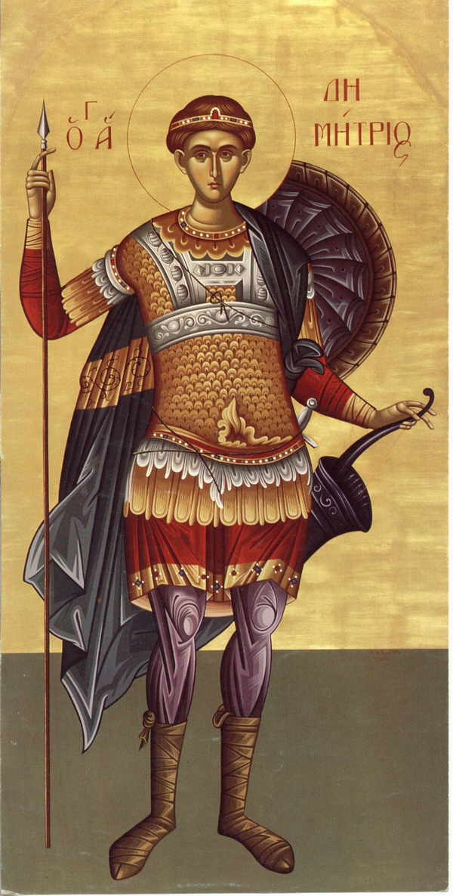
St. Demetrios Strategic Plan 2013-2014
St. Demetrios Greek Orthodox Church
Perth Amboy, New Jersey

Slide 2
MISSION, VISION, VALUES
MISSION The Mission of St. Demetrios Church is to continually create a sacred community, sharing faith, wisdom and love all dedicated to serving our Lord and Savior Jesus Christ whom with the Father we shall worship and glorify in all that we say, do and feel. We seek to inspire a commitment among our members, to one and other, to the greater Orthodox community and the Pan Christians of the world through the study of the bible, observance of the liturgy, receiving the communion of salvation, and performing by word, deed and thought our love of God from this time and forever more.

Slide 3
MISSION, VISION, VALUES
VISION The St. Demetrios community will be a warm, welcoming and socially responsible congregation of Orthodox Christians who pray, learn and grow. We will be inspired by the Christian martyrs such as our Patron St. Demetrios, Άγιος Δημήτριος της Θεσσαλονίκης, who was fervent in his faith and inspired many to Christianity, while helping others, such as helping the young Christian Nestor to overcome all odds in his single combat with the giant Lyaeus.

Slide 4
MISSION, VISION, VALUES
VALUES The Congregation of St. Demetrios should be governed by Four Main Values:
WORSHIP (Liturgia): A SPIRITUAL RESURGENCE
WITNESS (Martyria): MANIFESTING THE FAITH
SERVICE (Diakonia): MINISTERING THE FAITH
FELLOWSHIP (Koinonia): COMMUNION IN THE FAITH

Slide 5
WORSHIP (Liturgia) “He that eats flesh and drinks my blood dwells in me, and I in him.” (John 6:56)
WORSHIP (Liturgia) refers to our relationship with God through prayer, worship and the sacramental life. It is through Liturgia that we actually experience and get to personally know the personal Godhead — who is the Father, and the Son, and the Holy Spirit, “the Trinity, one in essence, and undivided". How and why each practicing Orthodox Christian worships God is an essential question that each must be resolved if he is to be a true member of Christ's Church.
The Divine Liturgy and the Sacraments of the Orthodox Church provide basic spiritual nourishment, but they must become a meaningful personal experience for the worshipper, and not simply an empty form.
Liturgia, then, means encouraging and developing a penetrating program for spiritual growth, both as individuals and as groups. All other dimensions of Christian life depend on this. Man does not live by bread alone, but must seek and come to Christ, be nourished by Him and confess Him as Lord.

Slide 6
WITNESS (Martyria): MANIFESTING THE FAITH “If any man will come after me, let him deny himself, and take up his cross, and follow me." (Matthew 16-24)
Worship is just the beginning. Man is both a spiritual and a physical being, and therefore the spiritual reality is expressed through the physical world. We cannot only have faith, we must also exemplify it in our life.
WITNESS (Martyria) is the living and witnessing of Christianity to others within the faith, to those who may have left the faith, and to those outside the faith, by sharing and actually living the Gospel Of Jesus Christ.
Witness (Martyria) is the logical extension of worship (Liturgia). If we are united with God, we will certainly reflect Him in our daily life.

Slide 7
SERVICE (Diakonia): MINISTERING THE FAITH “Truly, I say to you, as you did it to one of the least of these my brethren, you did it to me." (Matthew 25:37-40)
Christ came not to be served, but to serve, and He urges us to do the same. We can live in the image of God by loving and serving mankind. Orthodox Christians, and especially young adults and adults, may use their respective "charismata" (God-given grace/gifts/talents) to be kind and merciful just as Christ was when He walked among the sick, the poor, and the down-trodden … and extended His holy hand.
We all share in the mission of the Church, working side by side together with the ordained priest. SERVICE is lay ministry.
Each person is blessed with unique God-given talents, and each person is called by God to offer their very life, in love and thanksgiving, and to use their talents, not to bury them in the sand. Diakonia is a call to each Orthodox Christian to energetically participate in the active ministry of the Church.

Slide 8
FELLOWSHIP (Koinonia) “You shall love the Lord your God with all your heart, and with all your soul, and with all your mind. This is the great and first commandment, and the second is like it, you shall love your neighbor as yourself, on these two commandments depend all the law and the prophets." (Matthew 22:37-40)
In Fellowship (Koinonia) we are one.
FELLOWSHIP refers to the way in which the Orthodox Christian brings his faith into his daily and social life.
We begin to realize and become aware that Christ is the focal point of all our activities and relationships with one another. Our love for Christ and our faith in the Holy Spirit begins to guide us as we center our lives around loving one another the way Christ loves us, unconditionally, unselfishly, and wholeheartedly.
INSPIRED by Father Michael Lewis.

Slide 9
What It Is — and Isn’t: A STRATEGIC PLAN.
A Strategic Plan is a tool that provides guidance in fulfilling a mission with maximum efficiency and impact. If it is to be effective and useful, it should articulate specific goals and describe the action steps and resources needed to accomplish them. As a rule, most strategic plans should be reviewed and revamped every three to five years.

Slide 10
Strategic Vs. Operating Plan
An Operating Plan is a coordinated set of tasks for carrying out the goals delineated in a strategic plan. It thus goes into greater detail than the strategic plan from which it is derived, spelling out time frames and the roles of individual staff and board members, for example. It also has a shorter horizon than a strategic plan — usually one fiscal year.

Slide 11
Strategic vs. Business Plan
A Business plan is typically focused on the actions and investment necessary to generate income from a specific program or service. A business plan includes information about an organization’s products, competitive environment and revenue assumptions.

Slide 12
10 Key Steps to Successful Strategic Planning for Non-Profits
A clear and comprehensive grasp of external opportunities and challenges.
A realistic and comprehensive assessment of the organization’s strengths and limitations.
An inclusive approach.
An empowered planning committee.
Involvement of senior leadership.

Slide 13
10 Key Steps Continued
Sharing of responsibility by board and staff members.
Learning from best practices.
Clear priorities and an implementation plan.
Patience.
A commitment to change.

Slide 14
SWOT
SWOT Analysis

Slide 15
SWOT ANALYSIS

Slide 16
PROACTIVE vs. REACTIVE
DECIDE ON DIRECTION
DIAGNOSE PAST AND PRESENT PROBLEMS
GUIDANCE AND PLANNING
EXPLAIN COHERENT, COGENT AND COMPREHENSIVE ACTION PLANS

Slide 17
Why follow a strategic plan?
FOCUS REQUIRES US TO HAVE VISION AND ADDRESS WHAT MAY ULTIMATELY BE ACHIEVED.
PRIORITIES CREATE A LIST TOP TO BOTTOM IN ORDER OF IMPORTANCE, ENEGRY, EFFORT AND FINANCE.
RECOGNITION PROVIDES OPPORTUNITIES.
ASPIRATIONS ALLOWS STRATEGIES TO CONNECT WISHES TO REALITIY.
DECISIONS ACTION TO MAKE THINGS GO.

Slide 19
10 standing committees: Infrastructure for stability
STEWARDSHIP Provides for the operating expenses for the church.
WAYS & MEANS Meeting church wide need through revenue raising, dance festivals, raffles, and membership to those receiving sacrament and families.
LEGAL AND INSURANCE All filings with state, city, and Archdioceses. Annual review of all insurance policies, property casualty, employment. By-laws, corporate kit.

Slide 20
10 Standing Committees cont.
BUDGET FINANCE Quarterly annual review of spending income of all church organizations under charitable number. Sweep all accounts.
COMMUNICATIONS Web page e-blasts, bulletin, all letters from organizations, mailings, outreach programs, publicity & advertising.
ADMINISTRATIVE/STAFFING Priest, cantor, choir, maintenance salary, benefits insurance payment, church hardware, software, updates, order supplies, paper, ink, handbook of job duties.

Slide 21
10 Standing Committees cont.
CHURCH SERVICES Duty Roster, greetings, candles, service, choir, Sunday school, guests, special services, incense, altar supplies.
EDUCATION Sunday School, Greek School, Bible Studies, adult education, speakers bureau, young adults.
MINISTRY & OUTREACH Pan Orthodox, interfaith, charitable projects, faith based initiatives, field trip pilgrimages.

Slide 22
10 Standing Committees cont.
PHYSICAL PLANT Engineering, electrical, paint, trash, storm prevention, emergency evacuation, fire drills fire equipment, maintenance contracts.

Slide 23
ST. DEMETRIOS GREEK ORTHODOX CHURCH PERTH AMBOY, NEW JERSEY STRATEGIC PLAN TIME TABLE
Period: 2012-2013
Current Situation |  | Desired Situation
Diminishing membership |  | Increased membership
Prevalent feeling of spiritual non-fulfillment |  | Reestablishment of spiritual fulfillment
Absence of Youth programs |  | Increased Youth programs
Financial deficits |  | Creating budgetary guidelines/enhance revenue
Disharmony/Division |  | Reestablish a familial love in parish
Lack of clear vision, direction, planning |  | Create a short and long term plan, vision, direction
GAP

Slide 24
Key Indicators | Objectives
Membership and revenue diminution last two years. | Stop the loss of membership/stabilize revenue.
Interview subject/objective about worship deficiencies. Ex. No bible studies, prayer, participation ecumenically. | Reestablish worship as primary focus. Expand religious learning and activities as faith based.
Sunday school, Greek School Goya, Joy attendance dropping. | Create new innovative faith based activities for youth.
Stewardship down, nonoperation contribution down. | Establish transparency in expenses, spending, and expand giving opportunities.
Limited communications opportunity. | Bulletin work of one or two people must be community based/expand to web and hard copy with advertising.
Lack of tolerance and trust from community to Clergy and parish council. | Reestablish proper boundaries, guide posts and duties for clergy and parish council.

Slide 25
Specific Actions Planned to Fill the Gap:
 | Action | Due Date
1 | Reestablish participatory Sunday worship: greeting, candles, altar, choir. | Varies
2 | Recreate faith based programs for spiritual fulfillment: monthly prayer groups, monthly Bible studies, lecture series, ecumenical outreach to City & County with Pan Orthodox gatherings. | Jan-Mar
3 | Create family oriented faith based programs: crop walk, feed homeless, elder shut in visits, hospital ministry, and grave site care. | Jan – Mar
4 | Create blog and post relevant posts under church auspices. | Jan 15, Ongoing
5 | Re-establish family based activities-spaghetti lunch, pancake breakfast, 1st Sunday holy communion. | Feb 1, Ongoing
6 | Fix organ, get organist, get English AND Greek hymns sung with youth and adult choirs. Participate in interfaith choir programs. | March - Dec
7 | Create budgetary guidelines made know to community with profits and loss. Close deficit through newly created endowment effort. | Feb 15, Ongoing

Slide 26
 | Action | Due Date
8 | Design membership site offering and electronically on credit card with downloadable stewardship and non-operational giving with explanation of needs. | April
9 | Develop cooking and baking course within parish and open to the public. | July-Aug
10 | Identify other affiliate rentals of church halls to offer to increase building profits. | July-Aug
11 | Develop phone tree call for emergency situations. | March 30
ADDITIONAL GOALS
Reducing paper usage by 50% to decrease my impact on environment | Audit, budget guidelines and strategic planning to be repeated quarterly. | Have children and parents come to church together.

Slide 27
ACTION PLANS BY PARISHONER NEED:
Maximize Worship Experience |  | Generate New Parishioners |  | Revitalize Lapsed Parishioners
1 | Inclusive and respectful attitude of clergy. Make the liturgy meaningful with sermon and message. | 1 | Each committee chair should invite parishioners to participate in small ways. Candles, physical plant inspection, ways and means fund raising, chairing events. | 1 | Membership committee and Priest must mend fences and reinvite lapsed or absent congregation members.
2 | Improve customer service by sending thank you notes and 501 c3 tax receipts no less than 7 days after receipt. People want to know their donation served the church. | 2 | Rotate bible and epistle readings throughout community members young and old-male/female. | 2 | Invite lapsed members to special church events: St. Demetrio’s night, holy week, and Christmas service.
3 | Physical plant of church should be accessible, clean and presentable. | 3 | Invite other Orthodox worshippers to bible study, prayer worship. | 3 | Place ill members on prayers list for prayer group and community with family members follow up not just the person who is ill.

Slide 28
ACTION PLANS BY PARISHIONER NEED cont.
Maximize Worship Experience |  | Generate New Parishioners |  | Revitalize Lapsed Parishioners
4 | From entry to exit worship experience should be positive, warm, friendly and upbeat. | 4 | Place at least 5 guest-blogging posts per month. | 4 | Make lapsed members honored guests at events such a glendis, breakfast.
5 | Communication by bulletin, web, e-blast should prepare worshippers for knowledge of bible reading, hymn, saints holidays. | 5 | Enhance web page to include music icons heritage information. | 5 | Encourage legacy giving to those who have had family here but may have moved out of state in the family name.
6 | Youth should feel inclusive in spiritual function not just extra-curricular. | 6 | Offer novel programs for Orthodox Christians to participate. Greek school to the public- why not? | 6 | Create permanent honor roles of plaques, furniture altar offerings in honor of family members or events.

Slide 29
Key Strategic Initiatives

Slide 30
Key Strategic Initiatives cont.

Slide 31
Priorities for 2013
FIRST: To reestablish fiscal control and transparency

Slide 32
Priorities for 2013
SECOND: To reestablish faith based initiatives throughout all church programs, reestablishing a familial, loving and prayerful congregation.

Slide 33
St. Demetrios Life Survey for Congregation Perth Amboy New Jersey
Total of 40 participants
31 responded in English
9 in Greek

Slide 34
St. Demetrios Life Survey for Congregation Perth Amboy New Jersey
Part 1: You & Your Congregation

Slide 35
1. How often do you go to worship services at this congregation?

Slide 36
2. How long have you been going to worship services at this congregation?

Slide 37
3. Are you current in your stewardship pledge?

Slide 38
5. To what extent do the worship services or congregation help you with everyday living?

Slide 39
St. Demetrios Life Survey for Congregation Perth Amboy New Jersey
Part 2: About Your Faith

Slide 40
6. How often do you spend time in private devotional activities? (such as prayer, meditation, reading the Bible alone)

Slide 41
7. Over the last year, how much have you grown in your faith?

Slide 42
8. Agree or disagree: “My spiritual needs are being met in this St. Demetrios Church”?

Slide 43
9. How satisfied are you with what is being offered here for children and youth (under 19 years of age)?

Slide 44
10. Does St. Demetrios Church have a clear vision, goals, or direction for its ministry and mission?

Slide 45
11. How often do you experience the following during worship services at St. Demetrios?

Slide 46
12. Do you agree or disagree: “I have a sense of excitement about our congregation’s future”?

Slide 47
13. Would you be prepared to invite to a worship service here any of your friends and relatives who do not now attend services at St. Demetrios?

Slide 48
14. To what extent does our priest take into account the ideas of those who worship here?

Slide 49
15. Of the following, which one best describes your opinion of the future directions of St. Demetrios?

